Slide 1
Kristen Carpenter, Chair-Rapporteur May 1, 2020
The UN Expert Mechanism
on the Rights of Indigenous Peoples

Slide 2
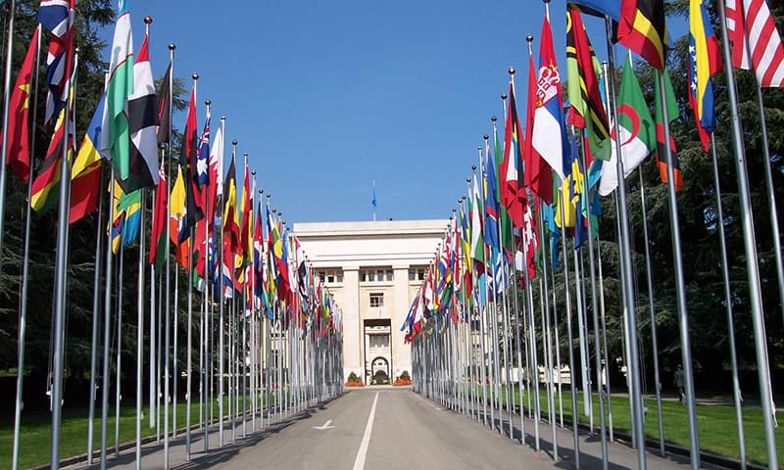
Access to (International) Justice

Slide 3
UN Declaration on the Rights of Indigenous Peoples (2007)
Implementing the Declaration
International
Indigenous/Tribal
Nation-States
Kristen A. Carpenter & Angela R. Riley, Indigenous Peoples & the Jurisgenerative Moment in Human Rights, 102 Cal. L. Rev. 173 (2014).

Slide 4
Indigenous Peoples Mechanisms at the UN
The Expert Mechanism is a subsidiary body of the Human Rights Council
EMRIP’s mandate is to advise the Human Rights Council on the human rights of indigenous peoples and assist states and IPs in meeting the aims of the Declaration on the Rights of Indigenous Peoples
HRC Resolution 6/36 (2007) as amended by 33/25 (2016)

Slide 5
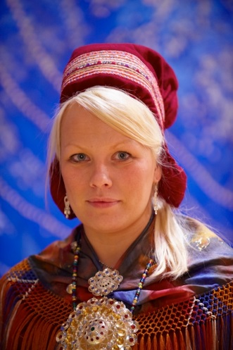
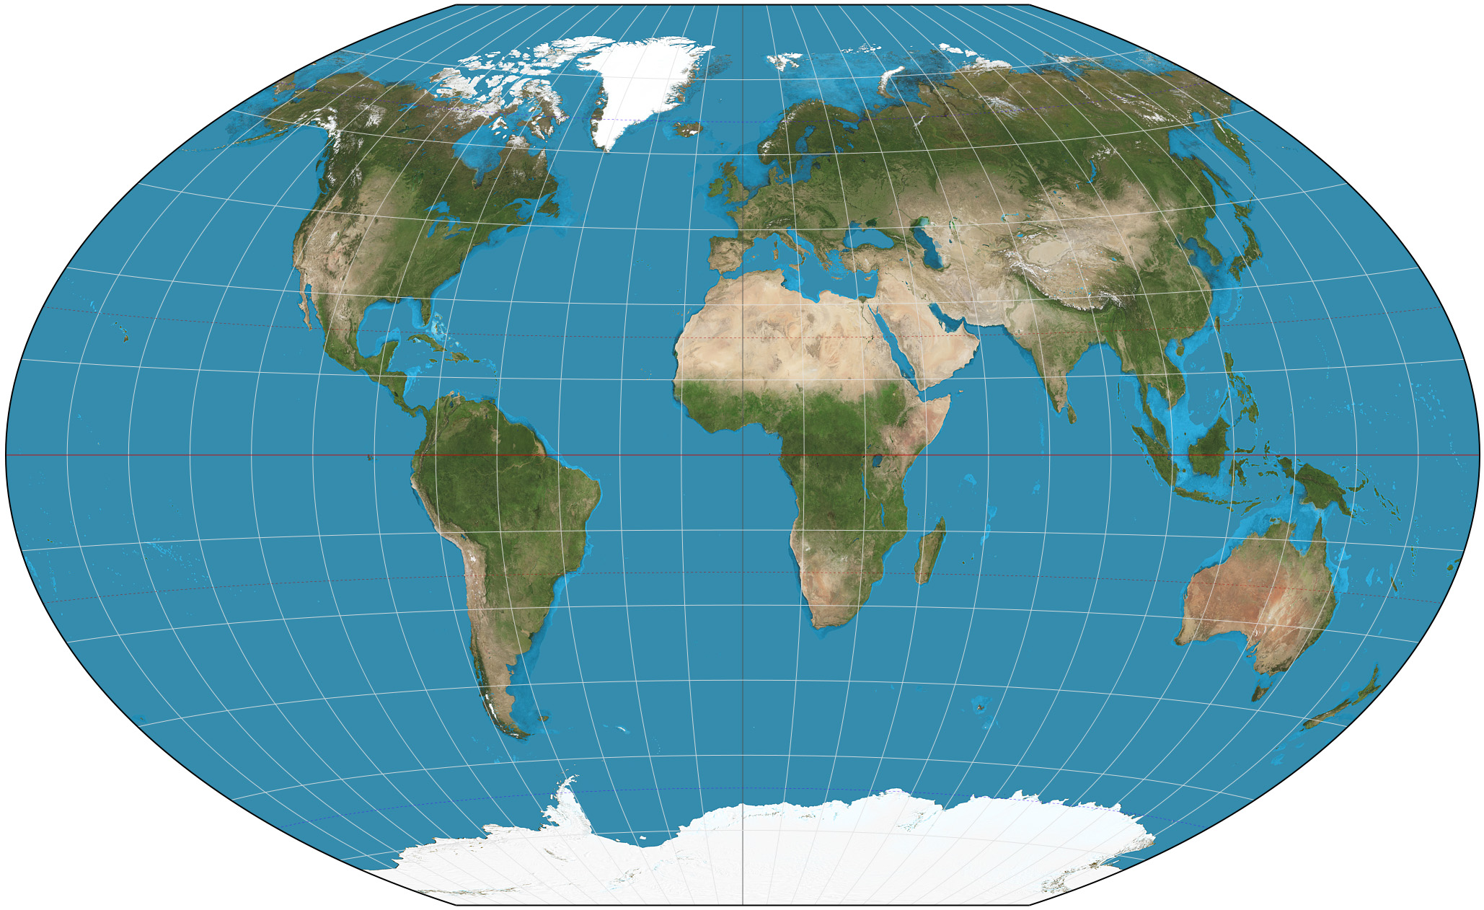
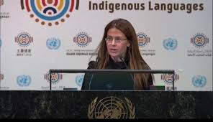
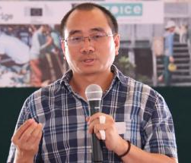
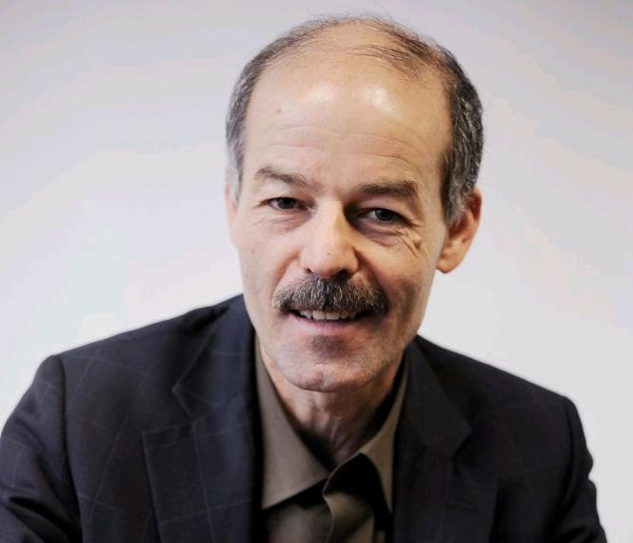

Slide 6
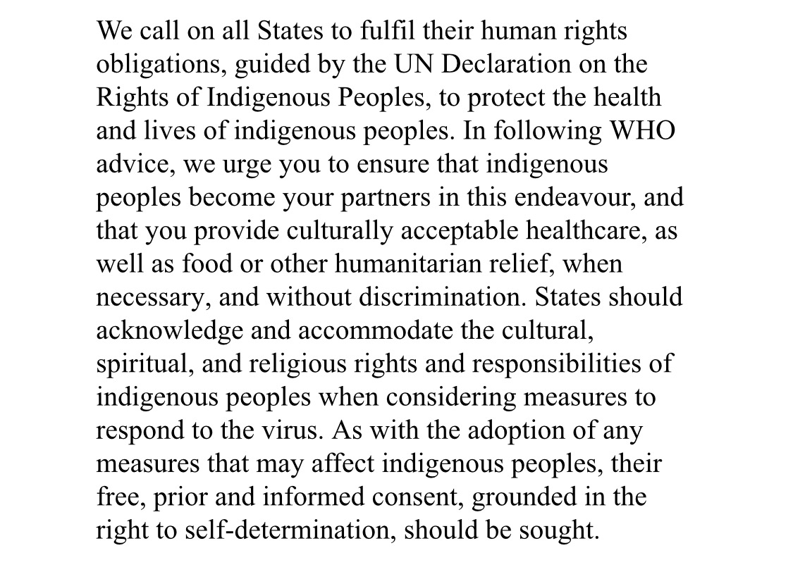
Full statement available at IITC website and
https://www.ohchr.org/en/issues/ipeoples/emrip/pages/emripindex.aspx

Slide 7
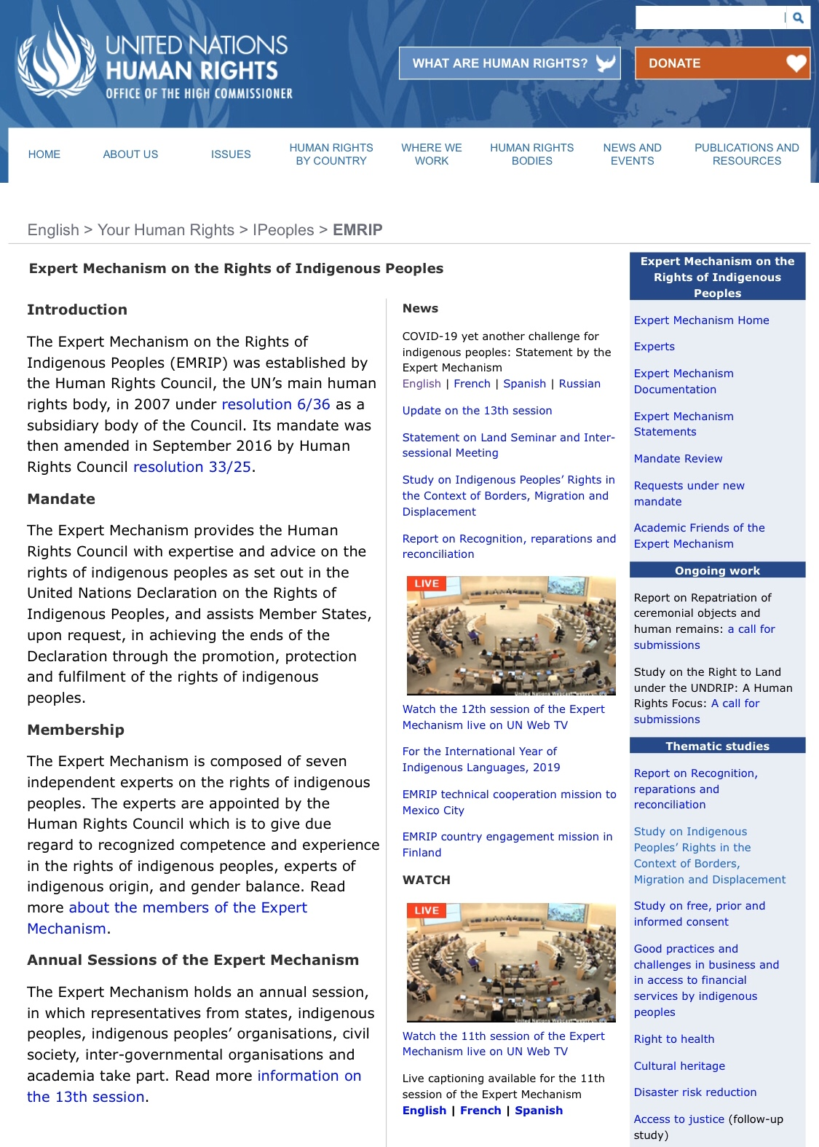
The Work of EMRIP
Country engagement
Facilitate dialogue
Provide technical advice
Coordinate among UN agencies
Studies and reports
Annual session
Advice to Human Rights Council
Coordinate with sister mechanisms
https://www.ohchr.org/en/issues/ipeoples/emrip/pages/emripindex.aspx

Slide 8
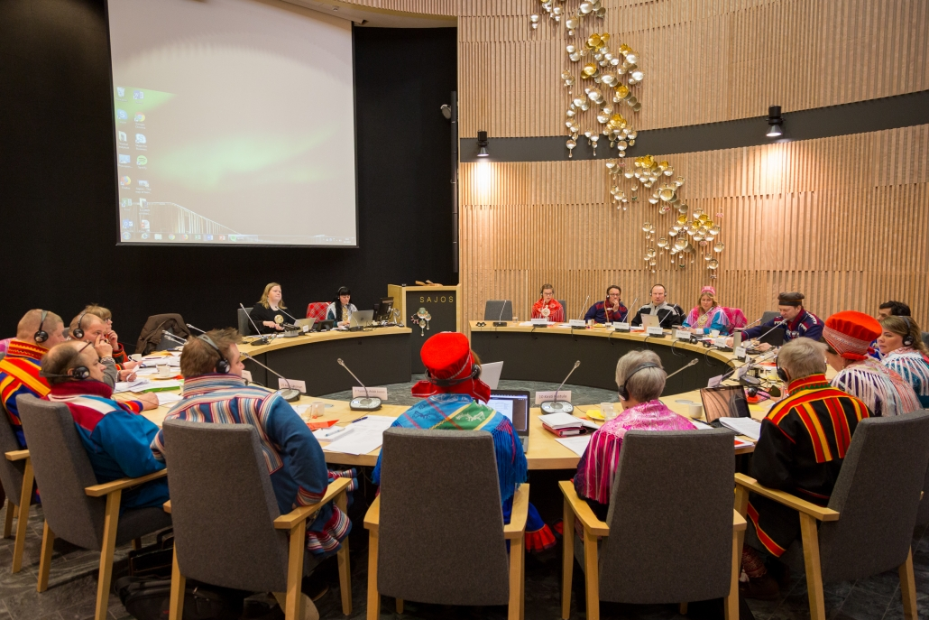
Country Engagement: Finland 2018
Provide technical assistance regarding reform to the Sami Parliament Act with respect to “who is Sami” for purposes of voting, consistent with the Declaration’s provisions on self-determination, identity and governance.

Slide 9
Country Engagement: Mexico 2018
Provide technical assistance and capacity building to implement Mexico City constitution’s provisions on indigenous peoples’ rights

Slide 10
Country Engagement: New Zealand 2019
Assist Maori and the national government in developing a national action plan to implement the Declaration in New Zealand

Slide 11
Country Engagement: Yaqui People & Sweden (ongoing)
Facilitate dialogue & provide technical assistance regarding repatriation of a ceremonial object consistent with Declaration Arts 11 & 12

Slide 12
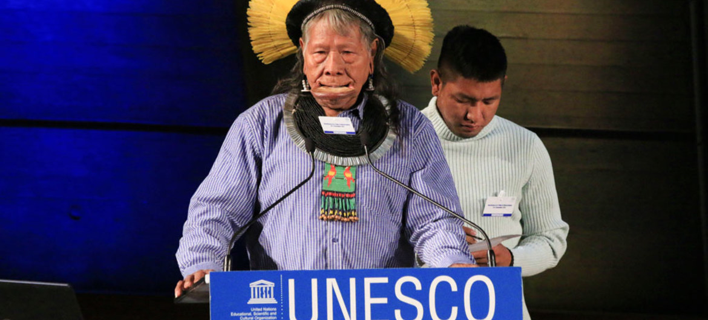
2015 Study on Cultural Heritage

Slide 13
2016 Study on Business & Entrepreneurship

Slide 14
2018 Study on Free Prior and Informed Consent

Slide 15
2019 Study on Borders, Migration, and Displacement

Slide 16
2019 Report on Recognition, Reparations, and Reconciliation
illustration by Kate Traynor

Slide 17
2020 Study on Indigenous Land Rights

Slide 18
2020 Report on Reparation of Indigenous Peoples’ Human Remains and Ceremonial Objects
“The Expert Mechanism hereby requests contributions from States, indigenous peoples, NHRIs and other stakeholders to this report. Submissions should be sent by e-mail to expertmechanism@ohchr.org, no later than 15 April 2020, in English, French or Spanish.”

Slide 19
2021 Study on the Rights of Indigenous Children

Slide 20
2021 Report on Self-Determination

Slide 21
Human Rights Council Session 42nd Session

Slide 22
